Slide 1
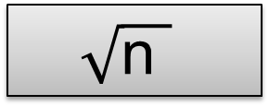
START
Puzzle 1
16
50% of this
n²
10% of this
x4
Six extra
1/7 of this
x9
$$\sqrt{\text{n} }$$
END
x8

Slide 2
START
Puzzle 2
£5
20% of this
x23
1% of this
1/3 of this
Deduct £2
x60
Add 30p
Double it
END
30% of this

Slide 3
START
Puzzle 3
300
Subtract 30
÷90
Minus 9
n²
n²
5/8 of this
Add 3
5/6 of this
END
5% of this

Slide 4
START
Puzzle 4
£5.50
Double it
x3
3/8 of this
75% of this
Take 100p
half of it
10% of this
Add 9p
END
÷6

Slide 5
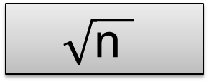
START
Puzzle 5
1000
25% of this
½ of this
x8
$$\sqrt{\text{n} }$$
Less 4
Remove 8
x4
5% of this
END
$$\sqrt{\text{n} }$$

